Slide 2
Next Hop of Istio After Graduation
Zhonghu Xu, Huawei Cloud

Slide 3
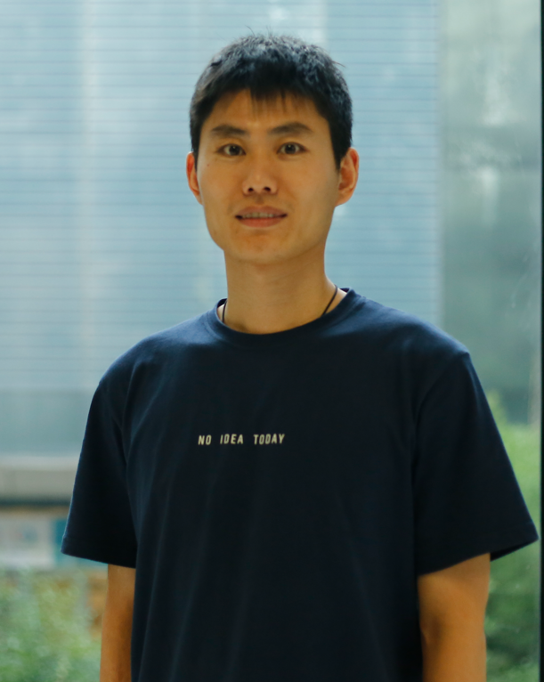
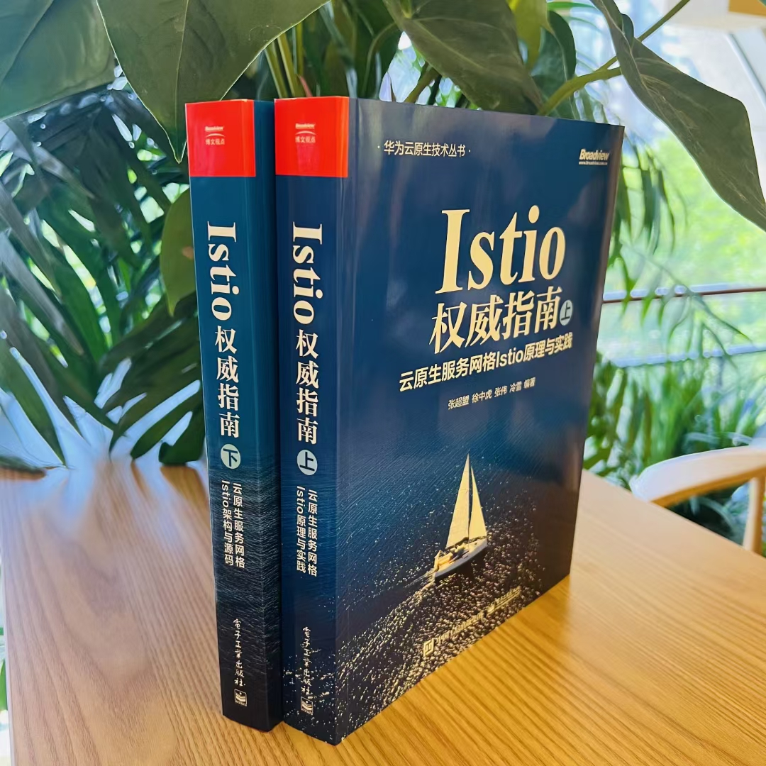
About Me
Istio steering committee member
Istio Maintainer
Volcano, Kurator Maintainer
Kubernetes member & core contributor
Google Open Source Peer Bonus Award
《云原生服务网格Istio》& 《Istio权威指南》Author
Github：https://github.com/hzxuzhonghu
Github @hzxuzhonghu
Twitter @ZhonghuXu

Slide 4
Istio Project Update
Ambient mesh alpha in 1.18
Sidecar remain recommended, sidecar container feature(alpha in k8s 1.28) supported in 1.19.
Gateway API support beta in 1.19
Support for dual stack clusters
Microsoft joined istio community after archive OSM(open service mesh)

Slide 5
Fastest CNCF Project to Graduate
CNCF
Graduation
Open Sourced
Release v1.0
CNCF
Incubating
Ambient Mesh
Announcing Istio's graduation within the CNCF
Started by teams from Google,IBM and Lyft
Istio is ready for production
CNCF accepted Istio
A new dataplane mode for Istio without sidecars.
2017.5
2018
2022.9
2022.9
2023.7

Slide 6
Thriving Istio Community
Adoption
More than 32 companies build platforms and services that install, manage, and implement Istio for you, including Google, IBM, Huawei, Intel, Tetrate, Solo, Azure and more.
461 Active Members and counting!
Over 10K+ contributors, including 1.8k+ active contributors in the last year
1951 contributing companies, 327 in the last year
65 maintainers across 8 working groups.
13 Working Group Leads
6 TOC members from 4 organizations
13 Steering members from 8 organizations, 4 of whom are elected by the community and the remaining seats come from their contributions.
Reference

Slide 7
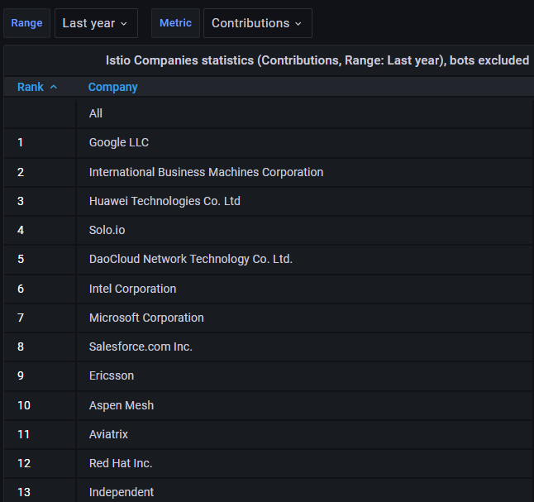
Thriving Istio Community
Reference: CNCF devstats

Slide 8



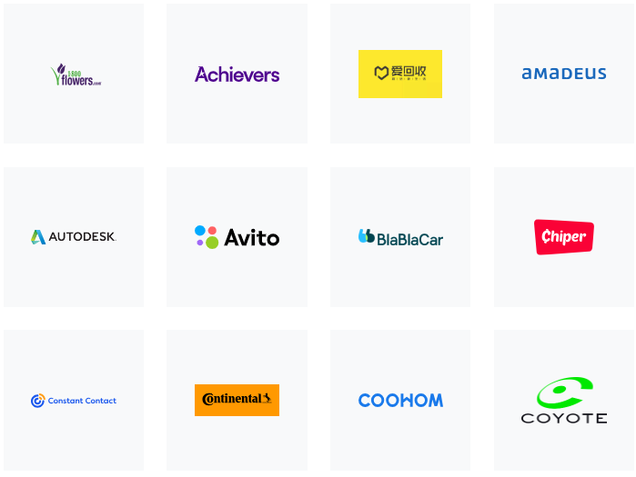


Istio Users
And more …
Reference

Slide 9
2023 Themes
Accelerating time to value for service mesh(0-mTLS)
TCO revolution
Open Community Growth
Continue to be Boring & Predictable

Slide 10
Istio 2023 Focus Areas
Ambient mesh iteration (planned to beta in 1.20)
Gateway API & GAMMA
Continue stability and feature promotions (Wasm Telemetry)
Integration with other open source cloud native projects and standards

Slide 11
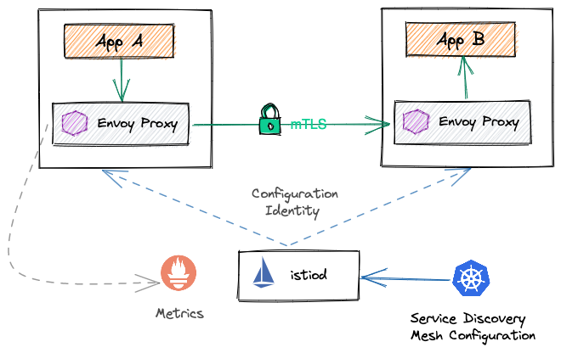
Classical or Standard Istio - Sidecar
OPERATIONAL
COMPLEXITY
OVERHEAD
COST
PERFORMANCE
Sidecar continues to be the recommended deploy model in 2023

Slide 12



Istio Ambient Mesh
A new model besides sidecar, that defines a new sidecar-less data plane.
Simplify
Operations
Cost
Reduction
Improve
Performance
https://istio.io/latest/blog/2022/introducing-ambient-mesh/

Slide 13
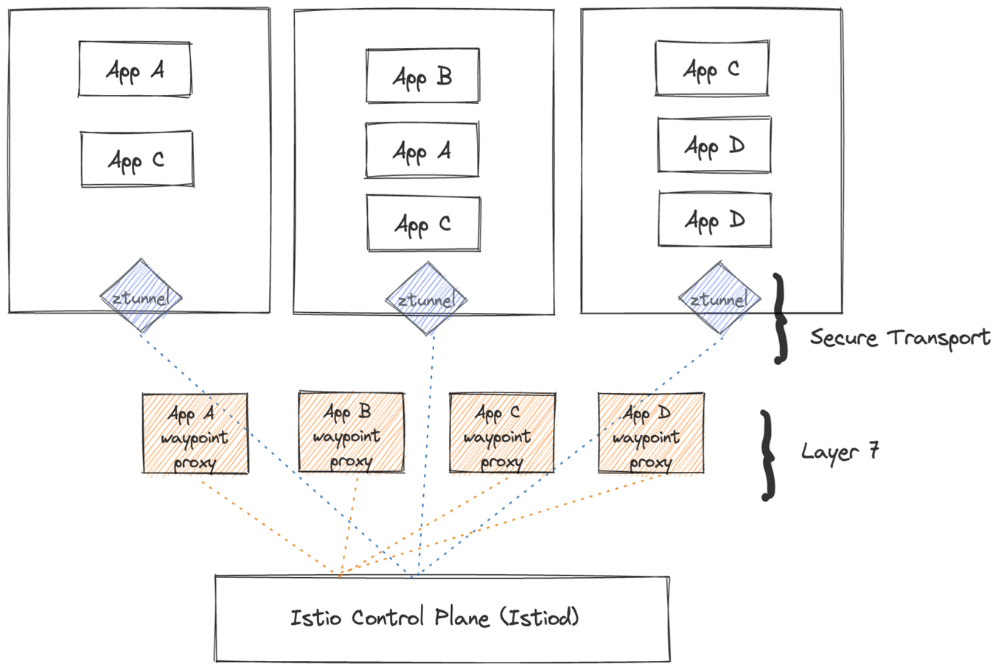
Ambient Mesh Architecture

Slide 14
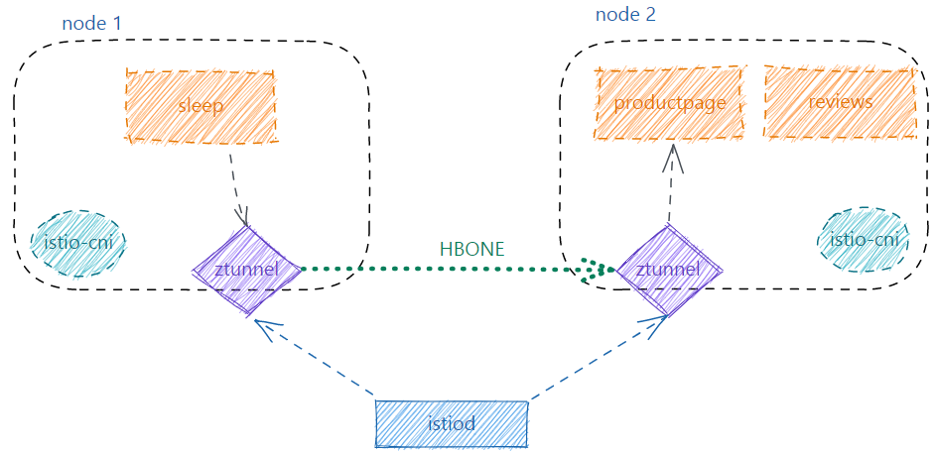
Ambient Mesh Architecture

Slide 15
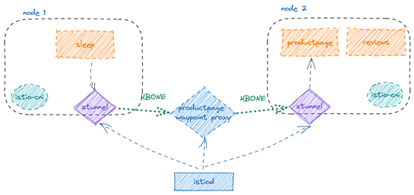
Ambient Mesh Architecture

Slide 16
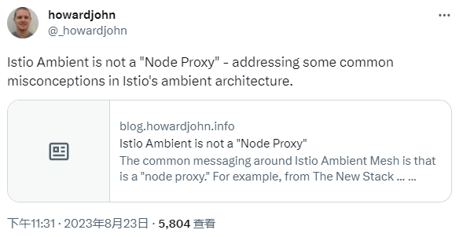
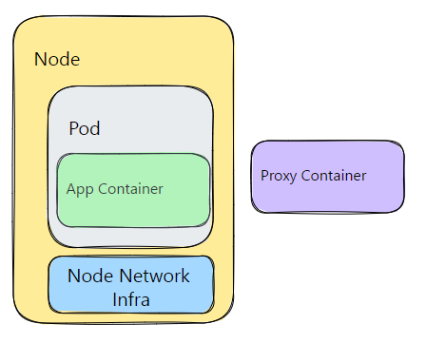
Is Istio Ambient Mesh Secure?
Istio Ambient is as secure as sidecar
Reference - Ambient Mesh Security Talk
Isn't there still a proxy on the node, though?
- It is more similar to kube-proxy

Slide 17

Can Sidecar & Ambient Co-exist?
Istio Control Plane
P
P
P
Cost Flexibility
P
P
P
P
P
P
P
P
P
Operational Flexibility
P
P
P
waypoint proxy
waypoint proxy
P
P
P
ztunnel
Performance Flexibility
Sidecar
Sidecar-less

Slide 18

How can you get involved?
Join Istio slack
Attend Istio events
Reporting bugs & security vulnerabilities
Become a code contributor
Participate in Working Group & TOC meetings
Slack QR Code

